Slide 1


PYTHON ENDSEM
PROJECT
GROUP-12

Slide 2
TEAM MEMBERS
ALAJANGI VENKATA SATYA-CB.EN.U4AIE22005
KOLLA LOKESH-CB.EN.U4AIE22027
GOLI SURYA TEJA-CB.EN.U4AIE22069
YEDUPATI KRISHNA PRASAD-CB.EN.U4AIE22070

Slide 3
ATTENDANCE
SYSTEM
WITH
FACE RECOGNITION

Slide 4

INTRODUCTION
Face recognition technology has revolutionized the attendance systems industry by offering a substitute for labour-intensive manual processes.
Through the use of distinguishing facial characteristics, this biometric approach accurately identifies and verifies people. Face recognition, which is based only on camera-captured facial pictures and is non-intrusive, is a practical and user-friendly alternative to fingerprint or iris scans.
The real-time processing of face data by the solution eliminates the long-standing problems with manual techniques and allows for accurate and timely attendance monitoring.

Slide 5
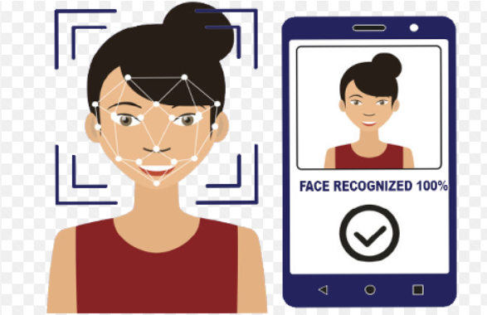
When used with a graphical user interface (GUI), facial recognition technology enhances system management and improves user experience. The GUI makes enrollment simple by capturing facial features through a streamlined interface.
This approach makes it possible for a large group of people to use the technology, even those with less technical knowledge. Additionally, the GUI simplifies maintenance by giving administrators an easy way to add or remove people from the attendance system.
Scalability is further enhanced by employing a folder-based database structure, which preserves system flexibility and permits dynamic organizational changes.

Slide 6
In order to address security and privacy concerns, face recognition systems prioritize data encryption and protection. To preserve people's biometric information, unique facial features or templates are typically employed in place of retaining facial images.
Technology and access control systems can coexist together to enhance security in areas that are off-limits. Furthermore, the system centrally records attendance information and provides administrators with comprehensive reports.
Face recognition in attendance systems provides a comprehensive response to the needs of modern organizations since these reports may be used for compliance monitoring, performance analysis, and payroll processing. Face recognition is being utilized extensively in attendance systems, and as technology advances, this will redefine efficiency and security in many different types of enterprises.

Slide 7
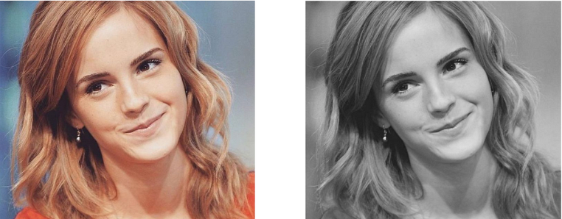
METHODOLOGY
The face detection method locates and identifies faces inside image or video frames using computer vision techniques and algorithms. This is a detailed description of the standard face detection process.
Obtain the input photo frame that contains the face. This was captured by a camera. A crucial initial step in computer vision applications is picture capturing.
In this instance, it's essential for duties like tracking attendance and identifying faces. For these sorts of applications, OpenCV is a popular choice since it simplifies photo processing and camera access.
Grayscale image input should be applied. Color information makes calculations easier to understand and expedites processing, but it's not always necessary for face identification.

Slide 8
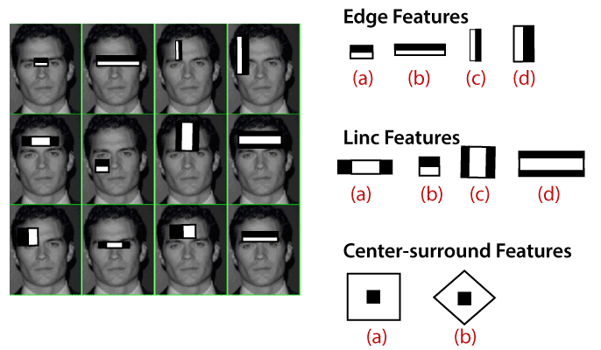
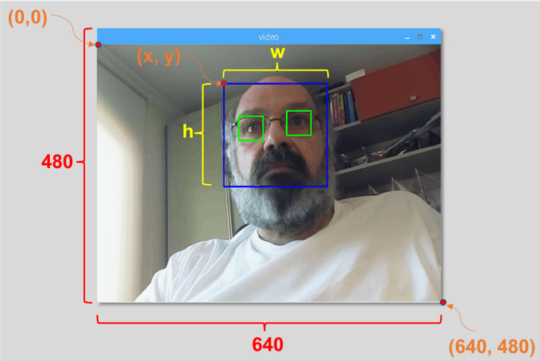
Apply a grayscale face detection method to the picture. Among the most popular and efficient algorithms is the Haar Cascade Classifier. This method uses a set of trained classifiers to identify regions of an image that most likely contain faces.
If faces are detected, draw rectangles around them to highlight their positions in the image.

Slide 9
Depending on the application, either save the picture with tagged faces or display the image with discovered faces.
The overall methodology may be adjusted to support various application requirements, choices for face detection algorithms, and other features such as multi-facial detection, real-time processing, and face tracking in video streams.
Face identification is a crucial part of many computer vision applications, from security and surveillance to human-computer interface systems.

Slide 10
CODE OVERVIEW
A Python program that builds a simple student attendance system via facial recognition. The graphical user interface (GUI) of the system was made with the help of the Tkinter toolkit.
The program allows students to view and log in to their attendance records as well as take images using their cameras to document their attendance. Teachers have the ability to review attendance records, update student data, and control who is allowed to use the camera.
The code implements a basic attendance system with facial recognition capabilities and a simple user interface for teachers and students to interact with the system.
Remember that the specific requirements and use cases should dictate how the system's security and privacy components are enhanced.
All the function explanation as follows

Slide 11
STUDENT REGISTRATION
Students can register using a different registration window (reg_window). In the registration form, students can provide a password and username, which are stored in the student_database.txt file.

Slide 12
LOGIN INTERFACE
On the login box, users (teachers and students) can enter their usernames and passwords. The instructor password, which is hardcoded when the "Login" button is pressed, and the student data stored in the student_database.txt file are compared with the entered credentials.

Slide 13
ATTENDANCE CAPTURE
Students can log their attendance by using the "Capture Attendance" option. The photo that was captured and saved in the attendance_images folder is used by face recognition software.The capture_student_attendance function manages the features for recording attendance, storing images, and performing facial recognition.

Slide 14
FACE RECOGNITION
Face recognition is implemented using the face_recognition library. The captured face encoding and the registered student's face encoding are compared by the program.If a match is found, the student's attendance is recorded in the attendance_records.txt file.

Slide 15
TEACHER PANEL
Teachers may also view student images, control camera access, delete students, monitor attendance records, and manage student information, among other functions.Similar features can be used by the instructor to carry out procedures such as removing students or blocking access to the webcam.

Slide 16
VIEWING STUDENT DETAIL
Teachers can view student details and images through dedicated buttons in the teacher panel. The view_student_details and view_student_images functions handle these functionalities.

Slide 17
BLOCKING AND UNBLOCKING
By inputting the usernames of those pupils, teachers can restrict or allow access to the camera for certain kids. The blocked_images.txt file contains the data.

Slide 18
LOGGING OUT
The "Logout" option allows both teachers and students to log out of the system. The corresponding windows are closed using the destroy() function.

Slide 19
GUI STYLING
The program initializes the main Tkinter window and sets settings for the GUI components, such as the background color, font, button appearance, and width of the entry field. The option_add method is used by the set_styles() function to establish the stylistic choices.

Slide 20
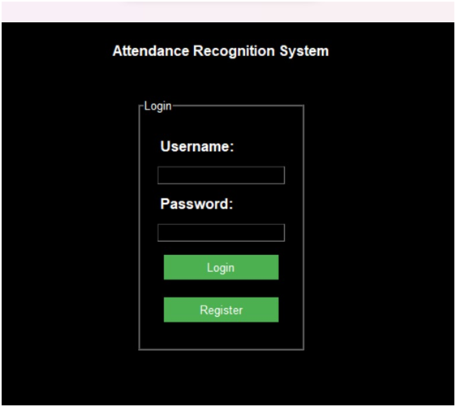
OUTPUT
We will receive the login portal where teachers and students may log in with their credentials after running the code on the command prompt.
If the student does not register, he can do so using the registration site.

Slide 21
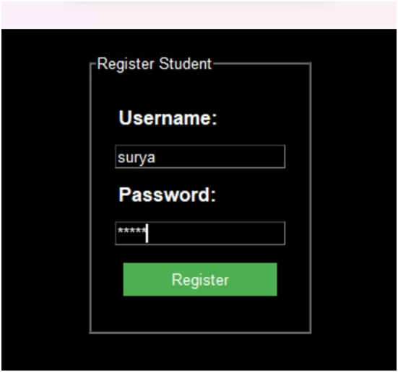
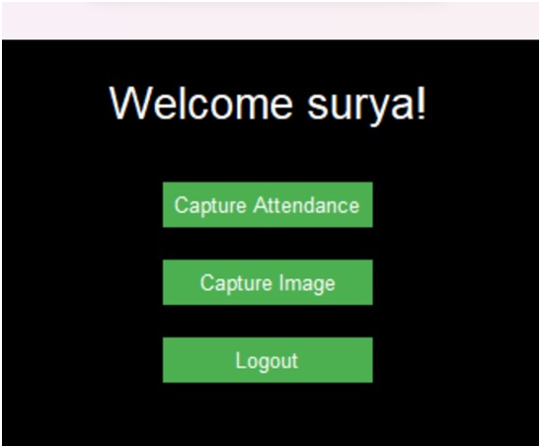
After get registered student can login with their respective credentials.

Slide 22
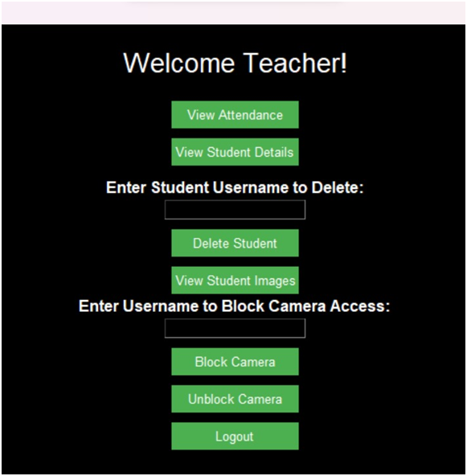
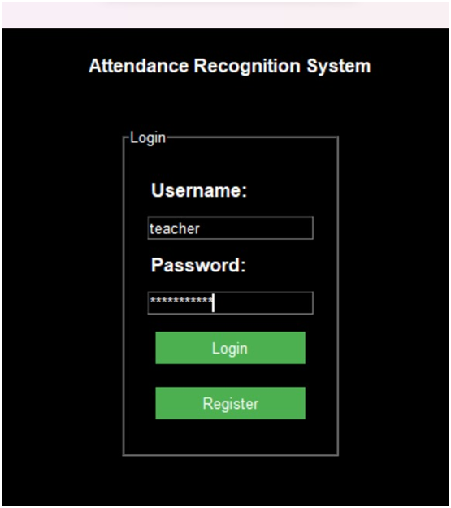
Teacher may log in using the default credentials, which are teacher@123 and user name:teacher.

Slide 23
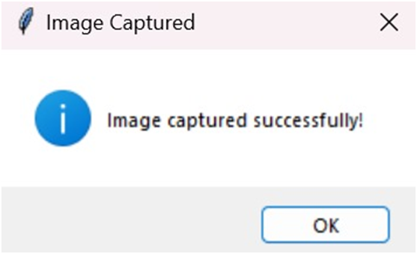
Students must take a picture of themselves as soon as they log in to their desks in order for facial detection to be utilized to take attendance.
Teachers are required to block student images once they are taken in order to prevent subsequent students from taking pictures of themselves until the instructor removes the block. This prevents future students from engaging in unethical attendance practices.

Slide 24
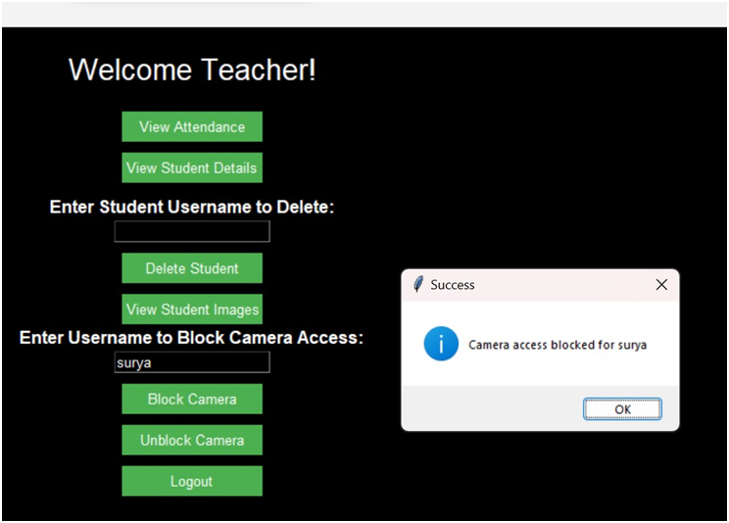
Following this, students can record their attendance by choosing a subject and faculty member. If the image recognition process matches the picture the student took, they will receive their attendance; if not, it will be denied.

Slide 25
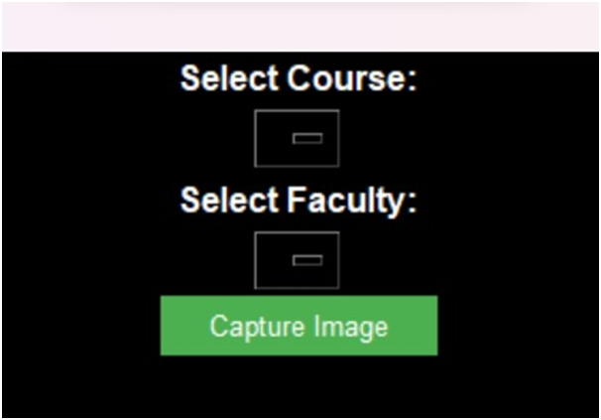
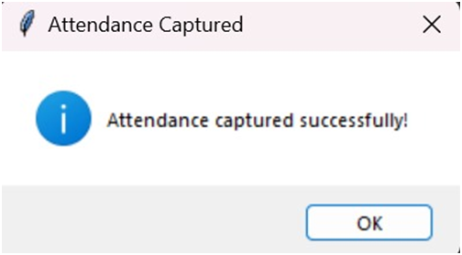
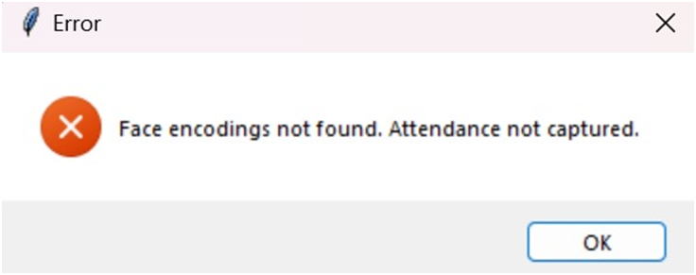

Slide 26
Once students give their attendance teacher can view students attendance in their desk.

Slide 27
THANK YOU

